Slide 1
Long Context Inference and
Key-Value Caching:
What It Is, and Why It Matters
Matthias Seeger
AWS Science for Developer Tools
Amazon Web Services

Slide 2
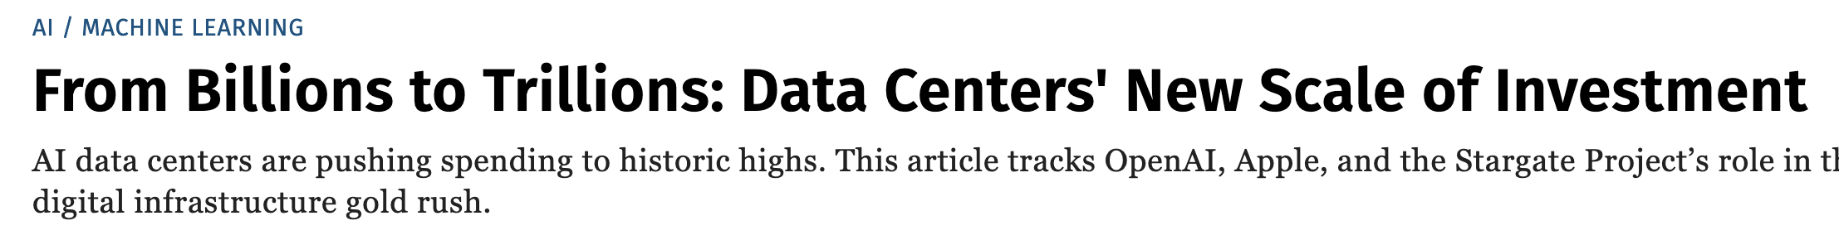
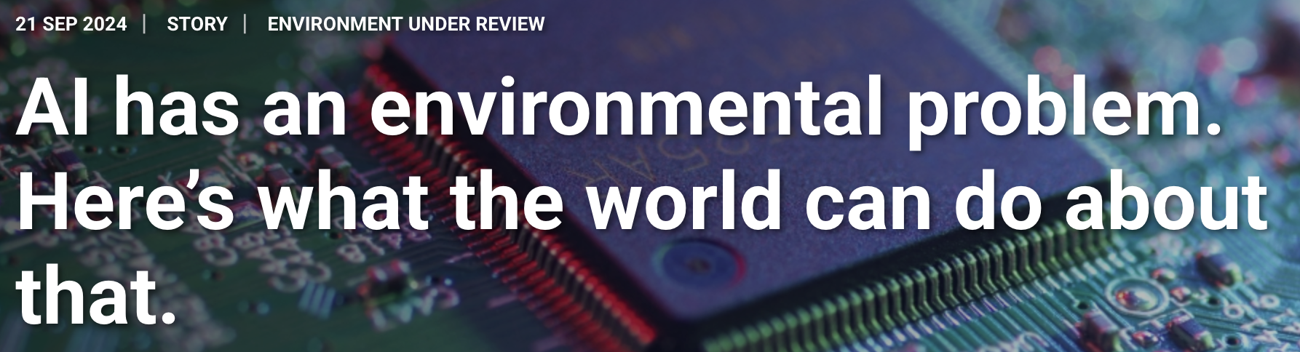
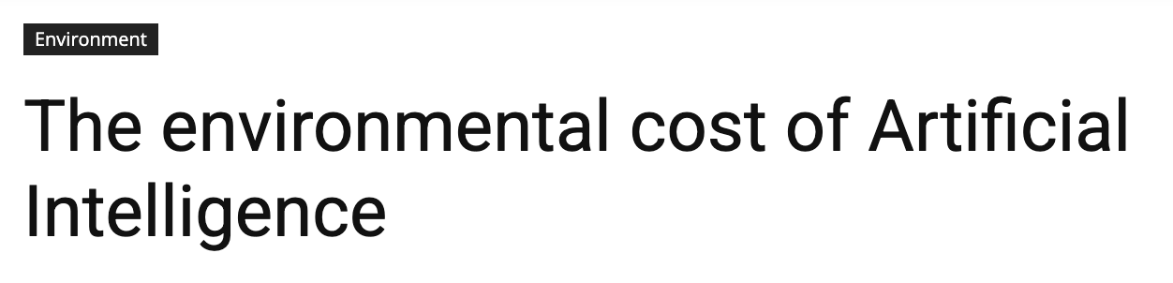
Why Are LLMs So Expensive?
Notes:
Why do we need all these data centers?
Best is Altman: We need nuclear fusion, to generate these tokens

Slide 3

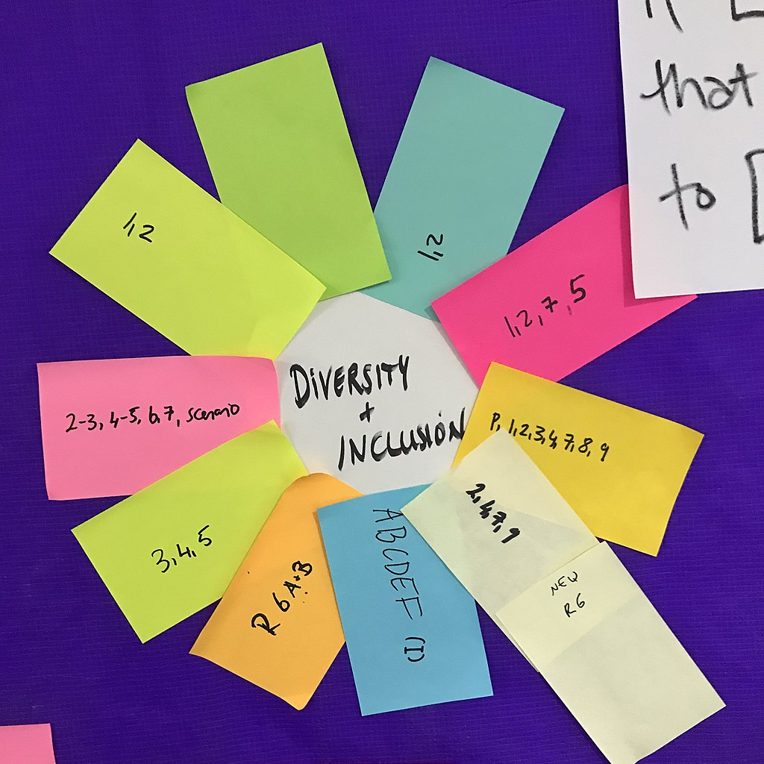
Why Are LLMs So Expensive?
Environmental Cost of Energy Production
GenAI: Diversity and Inclusion
Assistants: Latency matters
Human brain: 0.3kWh / day.
Nvidia H100: >10 kWh / day.

Slide 4
Agenda
01 | Transformer Inference
02 | Key-Value Caching and Long Context Inference
03 | Examples
04 | Outlook and Take-Aways

Slide 5
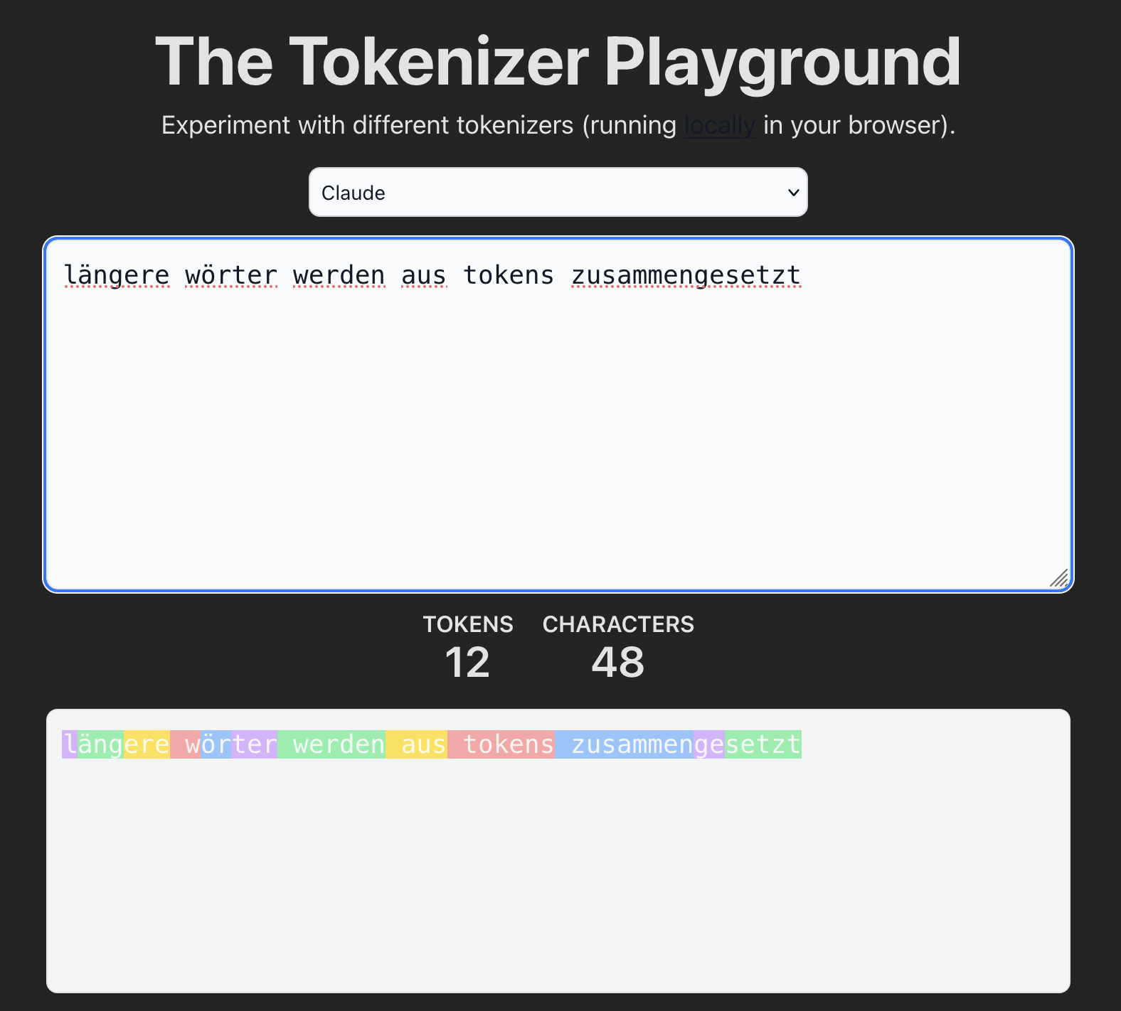
Token Embeddings
https://huggingface.co/spaces/Xenova/the-tokenizer-playground
Notes:
First: Chunk text into discrete units (tokens)
Subwords have emerged as best choice (can control vocabulary size; no OOV)
Tool you can play with tokenizers
English boring (most words are tokens), so I picked German

Slide 6
Token Embeddings
Token (e.g., word) maps to vector
Important Big Number: Embedding dimension d
Notes:
Map each token in vocabulary to an embedding vector (which is learned)
Vector represents token in context of others. Dimension is first important big number

Slide 7
Token Embeddings
Sequence of tokens → sequence of vectors
Important Big Number: Context width n
Notes:
Each token gets vector: Sequence of vectors
Next important big number: How many tokens can we handle?

Slide 8
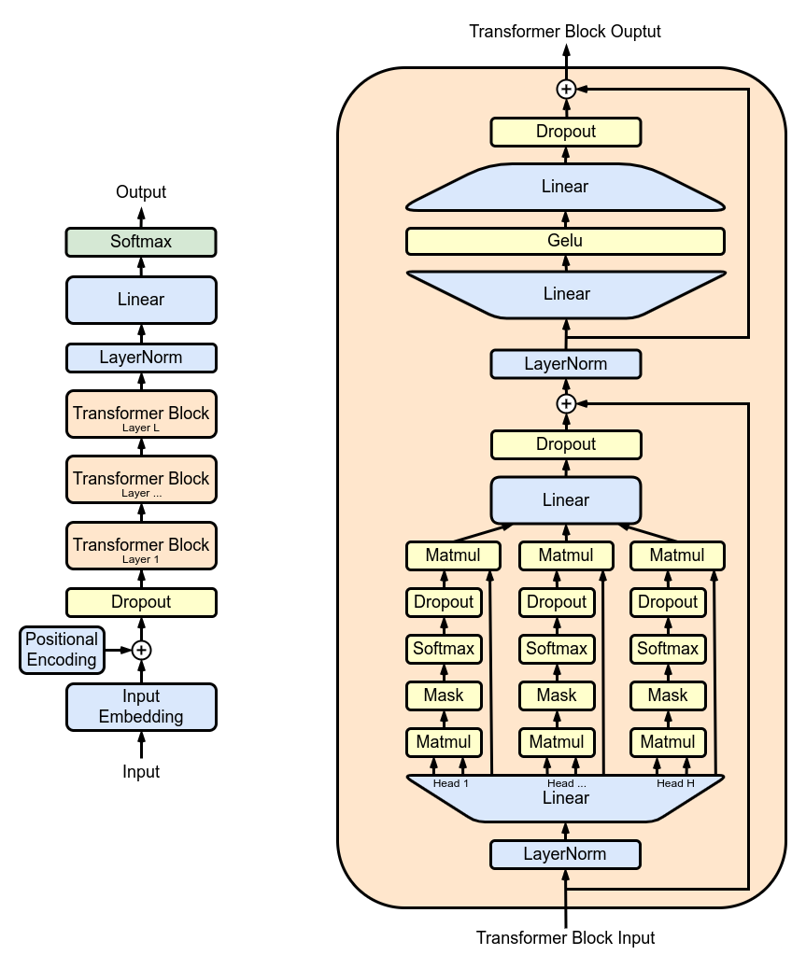
Transformer
Vector sequence
Vector sequence
more dependencies
more semantic meaning
Multi-head
self attention
(MHA)
Notes:
Transformer: Maps such sequences of vectors to sequences of same shape
Some stuff going on in every block. Most important: MHA
As we go up in layers: More dependencies between vectors (always causal!), more “semantic meaning”

Slide 9
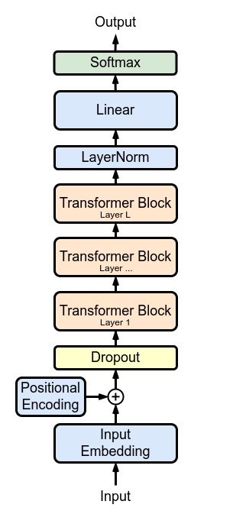
Transformer
Sequence of vectors → … → sequence of vectors
Important Big Number: Number of layers L
L layers
Notes:
- Final important big number: How many layers?

Slide 10
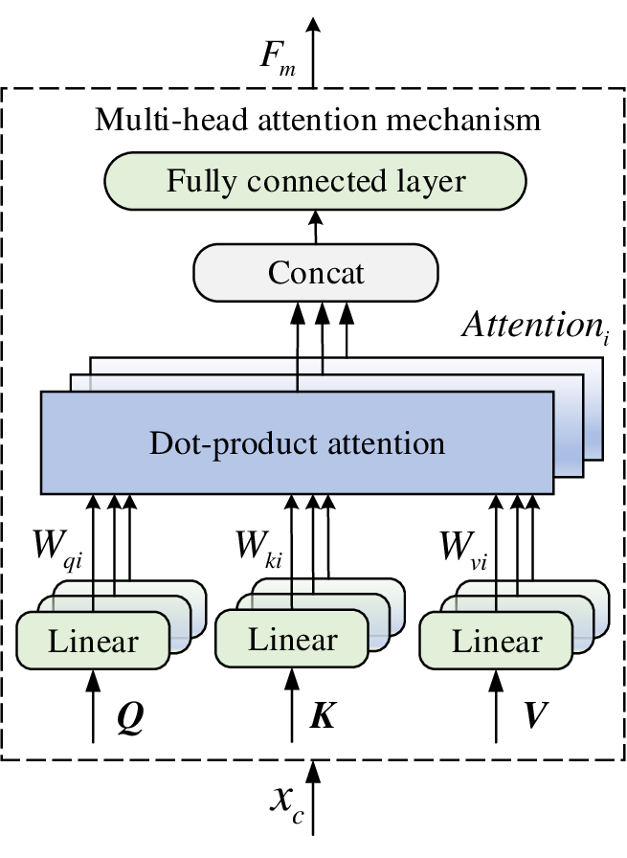
Multi-Head Self Attention (MHA)
Notes:
Most interesting part of block: Dependencies between tokens (vectors)
Idea: Smoothed-out (differentiable) retrieval, with dictionary {k : v}
Linear maps of inputs to Q, K, V: 3 x d^2 (another one at the end)
Dot product attention is causal (via masking): Current Q only with earlier K, V

Slide 11
Memory: Model Weights
Linear maps: O(d²)
In each layer
Foundational performance:
Large embeddings d
Many layers L
→ Big data centers!
L layers
Notes:
Key bottleneck with GPUs is memory
First: The model weights: O(L d^2)
For “foundational zero-shot performance”, “emergence”: Large L, large d

Slide 12
Transformer Inference
Single column for one token: O(d)?
MHA: Query attends to all !!
Notes:
What about inference? Token-by-token, just a column of the whole thing. O(d)?
NO! MHA is not local. Current Q depends on ALL K, V before

Slide 13
Memory for Inference
MHA: Query attends to all
Notes:
- Need to store the K, V. At end of sequence: O(L d n). Linear in n

Slide 14

Important Big Number: Context Width
Customers want Long Context n:
Complete code repositories
Chain-of-thought reasoning
Agentic workflows:
Many tools with complex I/O
Long chat histories
Notes:
VERY important big number n: Almost all exciting recent devs depend on that!
Elephant in the room

Slide 15
Key-Value Cache
For every layer!
values
keys
Notes:
I’d like to explain this story in terms of NumPy shapes
We have these two very big guys, and L times (for each layer)
Embeddings are split per head. Inference in run in batches

Slide 16
Key-Value Cache
What can we do?
Change MHA architecture
Distributed caching (more hardware)
Quantization
Selective KV caching (sparse attention)
values
keys

Slide 17
Change MHA Architecture
values
keys
n_groups < n_head
Q remains full size, K and V shared between heads
MQA, GQA, MLA (DeepSeek)
Pre-training decision (one-way door)
Notes:
Maybe the most obvious idea: Just change MHA!
Share K, V among several heads, but keep different Q
DeepSeek multi-head latent attention is clever variant of this
Big downside: Need to make decision for pre-training already. Willing to take this risk?

Slide 18
Distributed caching (more hardware)
values
keys
CPU offloading [FlexGen]
Distribution over multiple GPUs [Ring attention]
Could use multiple GPUs more effectively (data-parallel or model-parallel)
Notes:
Hierarchical: Use CPU as well [FlexGen; optimized for throughput, not latency]
Use multiple GPUs [Ring attention; mostly for gradient computations, fine-tuning]
Downside: Multiple GPUs can be more valuable for other things (larger batches, larger models)

Slide 19
Quantization
For every layer
values
keys
L-1 caches quantized at any time
Factor 2 (8-bit) or factor 4 (4-bit)
Notes:
No-brainer: Just do it
It works because each layer has a cache, and only one needs to be de-quantized at any time
Downside: Limited savings

Slide 20
Selective KV caching (sparse attention)
values
keys
cache_len << seq_len, fixed
Also token position index (batch_size, n_head, cache_len)
Cache policy: Which slots to evict when cache is full?
Notes:
A cache is a cache! Fixed size. Once full, need to evict slots
Keep index to track which slot holds which token position
Cache policy: When new K, V come in, which slots are overwritten?

Slide 21
Can Be Combined
values
keys
20x-40x reduction is achievable
Selective KV caching has largest potential
Notes:
Of course, all of this can (and should) be combined
Selective KV caching has the largest potential among these!

Slide 22
Long Context Inference
Prompt
Generate
Prefill (cache_len)
Chunks
(cache evictions)
Prefill with single forward (as in pre-training)
Each chunk and generated token needs slots to be evicted
Notes:
Process as much of prompt in one forward as you can (prefill)
Cache fills most of GPU memory: Process rest of prompt in smaller chunks
Too large chunks can lead to worse eviction decisions
Generation is always token-per-token

Slide 23
Lifting to Long Context: n_{train} → n_{inf}
[Su etal, NeuroComp 23]
Pretrain with context width n_{train}
Lift positional encoding (in attention): n_{train} → n_{inf}
Fine-tune with inference context width
Notes:
Pre-train with context width 8k to 16k
Lift model to much larger context width (100k, 1M)
Needs positional encoding in attention (depends on context width)
Fine-tune with long context instruction data

Slide 24

Example: Heavy Hitter Oracle (H2O)
[Zhang etal, NeurIPS 23]
MHA
H2O Cache
$m_{ts}$: How much s matters for t?
${\text{Score}}_{s}= \sum_{t}{m_{ts}}$ : Larger is more useful
Evict ${\text{argmin}}_{s∈C}$ ${\text{Score}}_{s}$
Notes:
H2O: Most basic adaptive policy
Score information in cache by how much it is being used

Slide 25
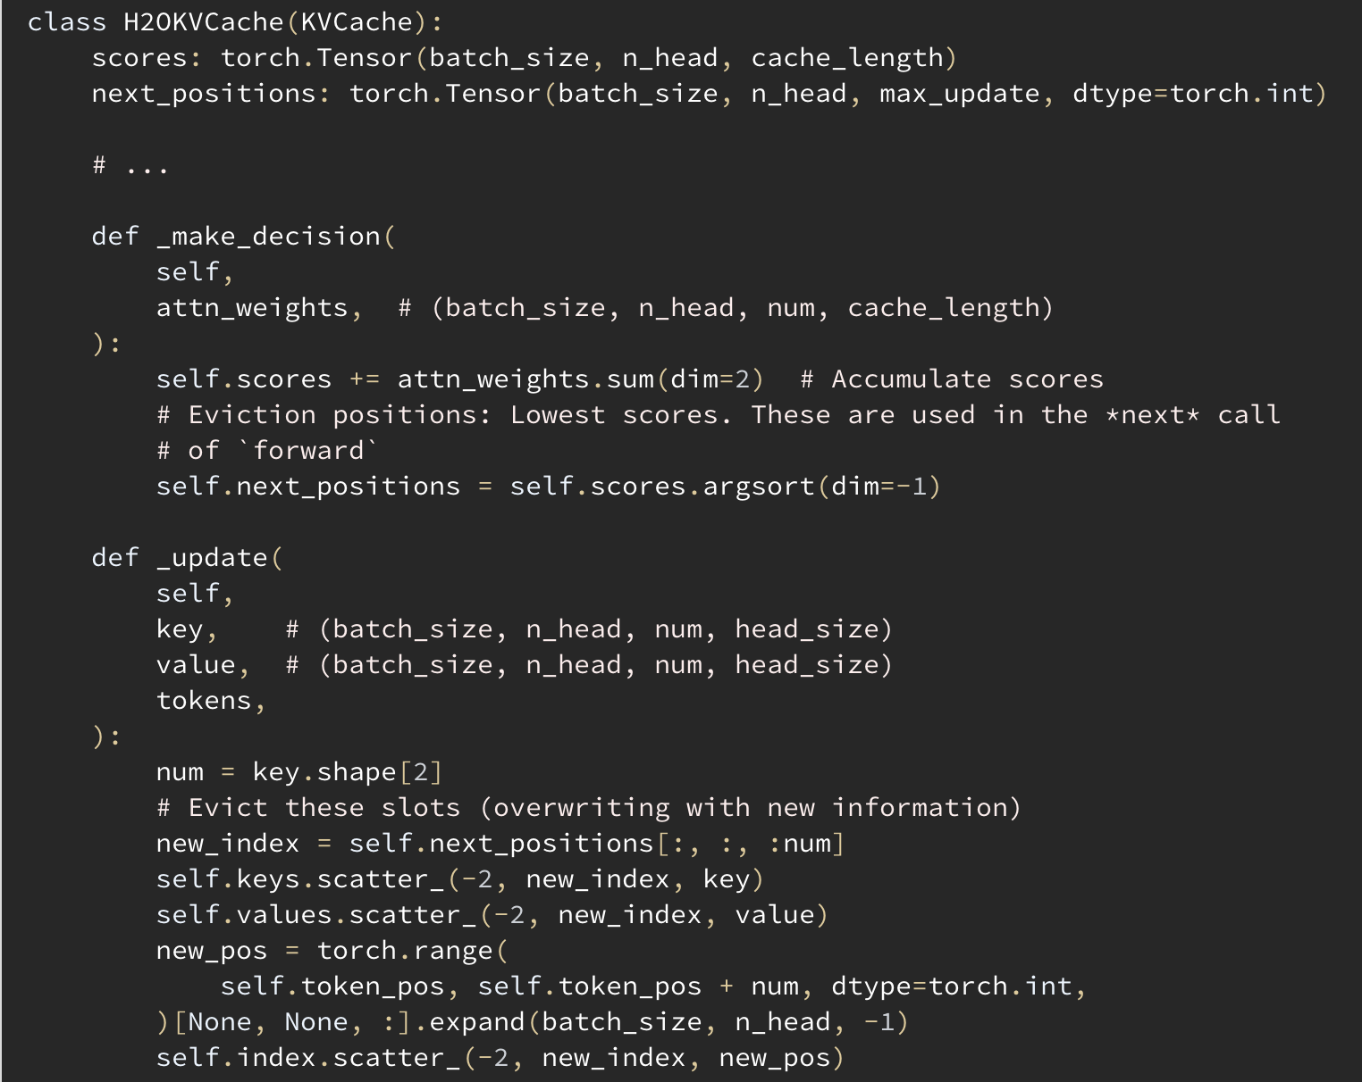
Example: Heavy Hitter Oracle (H2O)
[Zhang etal, NeurIPS 23]
Cumulative attention weights
Mark lowest for eviction
Overwrite slots
Notes:
Would like to show code, because it IS that simple

Slide 26

Example: FastGen
[Ge etal, ICLR 24]
Meta policy: Compare policies $C$ on initial prefill, pick best
Exact (dense) attention $M$ possible in prefill period
Can choose policy $π\left(l, b, h\right)$ per layer $l$, batch dim $b$, head $h$
All policies in a layer have same cost (cache length, quantization), but overall cost can be distributed across layers
Notes:
FastGen: Meta policy, best target for generic implementation
Score basic policies: How compare against dense MHA in prefill period?
Can select different winners per layer, batch dim, head!
Outer loop: Optimize costs (cache length, quantization bit size) between layers
Many simple policies can be scored at negligible extra costs

Slide 27

What Is The Deal?
H2O:
cache_len $≈$ seq_len/5 generally works.
10x (q:8-bit) or 20x (q:4-bit)
q-Hitter:
Combine H2O score with quantization error.
20x (q:4-bit)
FastGen:
Plug in your domain knowledge, picks the best for every inference, layer, head.
[Zhang etal, NeurIPS 23]
[Zhang etal, MLSys 24]
[Ge etal, ICLR 24]
Notes:
This can really make a difference: 10x or 20x memory reduction with little extra effort
FastGen: Highly configurable, will always pick the best (on initial prefill)

Slide 28

Take-Away Messages
We can make LLM inference work without spending billions
No one-size-fits-all:
  Adapt KV cache policy to use case
  Make it adaptive (H2O, FastGen)
  Use domain knowledge (e.g., structure of code)
What is prompting today, may be KV cache policy optimization tomorrow
Dive into the code! Details matter
(it’s easier than you may think, e.g. LitGPT)
https://github.com/Lightning-AI/litgpt

Slide 29
Outlook
Gradients and fine-tuning with KV caches:
Currently working on this
Open source software for selective KV caching?
  https://github.com/microsoft/MInference: Mostly FastGen
  https://github.com/FMInference/FlexLLMGen: Has H2O
Let’s fine-tune models to use our tools effectively:
Let’s own our agentic workflows
Get this out of the fringes!

